Slide 1




Cryptocurrency Analysis App
Notes:
1

Slide 2

TABLE OF CONTENTS
Problem Statement
Introduction
Tech Stack
Architecture
Methodology
WoW Factors of Project
Snippets of Code
Result and Discussions
Conclusion
Future Scope

Slide 3
PROBLEM STATEMENT
"Despite the growing interest in cryptocurrencies, investors often struggle to analyze and interpret real-time market data effectively.
The absence of accessible and user-friendly tools makes it challenging to track price trends, moving averages, and trading volumes, hindering informed decision-making.
This creates a need for an intuitive Cryptocurrency Analysis App that offers dynamic visualizations and insights, empowering users to navigate the complex crypto market with confidence and ease."

Slide 4
INTRODUCTION
"Welcome to the Cryptocurrency Analysis App!
This Cryptocurrency Analysis App is an interactive tool that provides insights into the performance of cryptocurrencies like Bitcoin, Ethereum, and Ripple.
It offers dynamic charts and graphs to explore price trends, daily returns, and trading volume contributions.
Powered by yfinance for real-time data fetching and Plotly for visualization.

Slide 5
TECH STACK
Streamlit: Framework for web app with user interface and real-time data visualization.
Pandas: Used for data manipulation, filtering, grouping, and calculations.
yfinance: Integration for real-time cryptocurrency price data fetching from Yahoo Finance.
Plotly: Tool for interactive visualizations like line charts and histograms for data analysis.

Slide 6
ARCHITECTURE
User Interface: Built using Streamlit, offering a sidebar for cryptocurrency selection and chart type.
Data Handling: Utilizes yfinance to fetch real-time cryptocurrency data, which is then processed using Pandas for analysis and manipulation.
Visualization: Plotly and Plotly Express are employed to create interactive charts, including price trends, moving averages, daily returns histograms, and monthly volume contributions.
Functions: Defined functions for data loading, chart display, and data analysis, ensuring modularity and maintainability of the codebase.

Slide 7
WOW FACTORS OF PROJECT
Real-Time Analysis: The code utilizes yfinance to fetch real-time cryptocurrency data, allowing users to analyze the latest trends, moving averages, daily returns, and trading volume contributions.
Interactive Visualization: With Streamlit and Plotly, the code creates interactive charts like line graphs, moving averages, histograms, and pie charts, providing users with dynamic and insightful visual representations.
User-Friendly Interface: Streamlit's sidebar and button functionalities offer a user-friendly interface, enabling users to select their preferred cryptocurrency, chart type, and manually refresh data with ease.

Slide 8
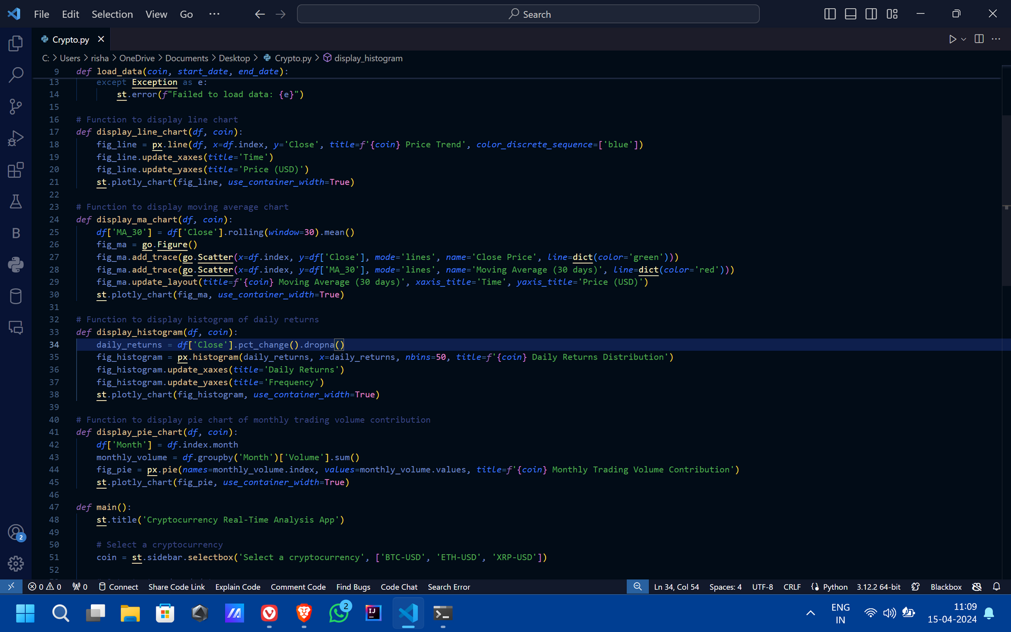
SNIPPET OF CODE

Slide 9
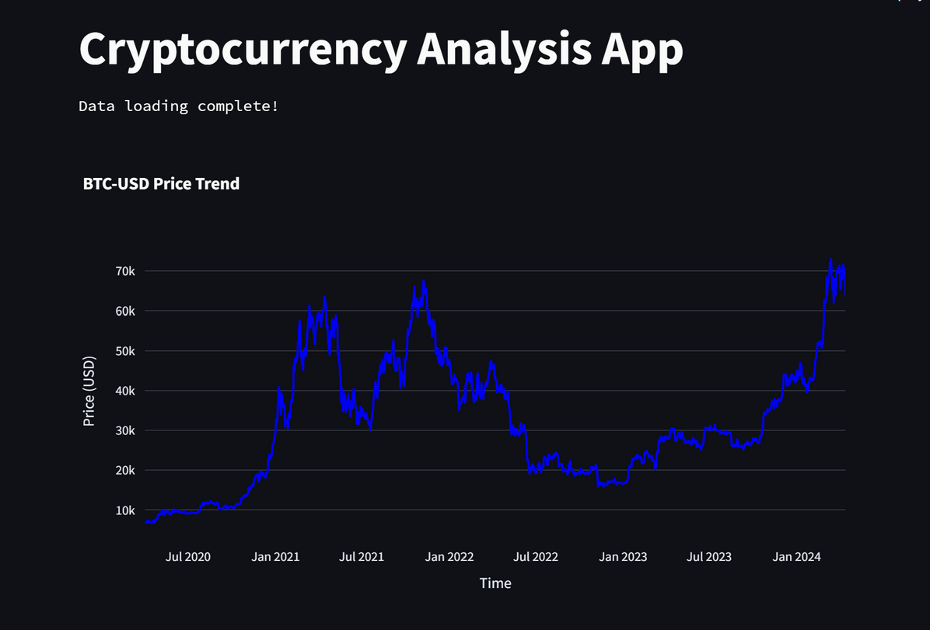
RESULTS AND OUTCOMES
PRICE TREND GRAPH

Slide 10
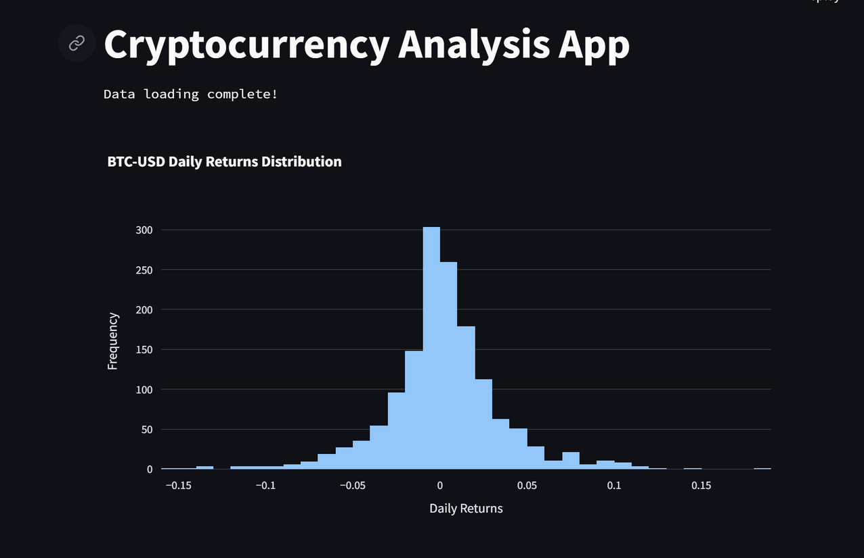
RESULTS AND OUTCOMES
DAILY RETURN HISTOGRAM

Slide 11
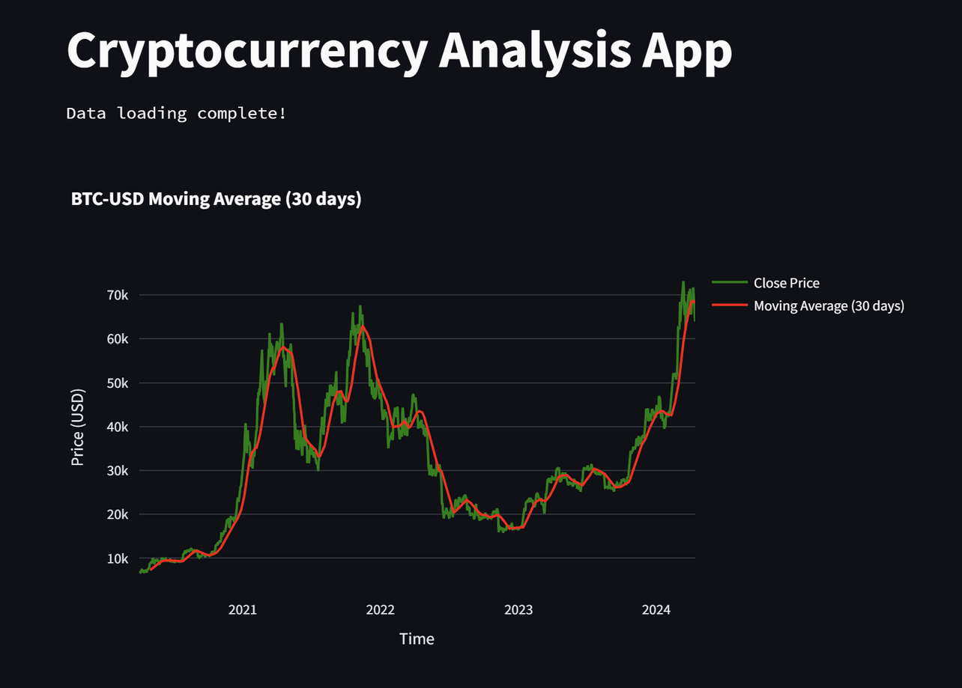
RESULTS AND OUTCOMES
MOVING AVERAGEN
(30 DAYS)

Slide 12
CONCLUSION
The Cryptocurrency Analysis App is a user-friendly tool built with Streamlit, providing real-time analysis of popular cryptocurrencies like Bitcoin, Ethereum, and Ripple.
Leveraging yfinance for data retrieval and Plotly for interactive visualizations, it offers insights into price trends, moving averages, daily returns, and monthly trading volume contributions.
Users can effortlessly select their preferred cryptocurrency and visualize data through dynamic charts, enhancing their understanding of market dynamics.

Slide 13
FUTURE SCOPE
The project can be enhanced by incorporating additional features such as predictive analytics using machine learning models to forecast cryptocurrency prices.
Integration of sentiment analysis from social media and news sources could provide insights into market sentiment.
Furthermore, adding portfolio tracking, alerts for price changes, and user authentication for personalized experiences can improve user engagement.
Additionally, expanding the range of cryptocurrencies and providing multi-currency comparison would cater to a broader audience.

Slide 14
THANK YOU !

